Slide 1
WebGLStudio
a Pipeline for WebGL Scene Creation
Javi Agenjo, Alun Evans, Josep Blat
KEYNOTE
Do Nhat Quang
Mail: donhatquang@sjtu.edu.cn

Slide 2
About Author
1st Author: Javi Agenjo, born in 1980 at Barcelona, Spain.
Computer Engineer working in 3D Graphics since 2005. Interested in videogames development and interactive applications, focused on using the 3D Hardware to create new ways of interaction.
Teach at the University Pompeu Fabra at Barcelona courses related to programming, graphics and games development.

Slide 3


About Author
1st Author: Javi Agenjo, born in 1980 at Barcelona, Spain.
Homepage: http://www.tamats.com/blog/
Twitter: @tamat https://twitter.com/#!/tamat
Email: javi.agenjo@upf.edu

Slide 4

Motivations
Paradigm shifting from Desktop to browser in all lightweight daily applications
Notes:
The big Change of App to user: Over the last two years a big change has been happening in the way applications are delivered to the end user.
Now all daily applications are moving to what is called "the cloud". Applications like
Cloud App: Mail (Gmail), office suites (Google Docs), Calendars, project managment.
But now a new breed is coming for more profesional intensive applications (Audio, Music, Video, Programming, 3D, ...).
(Mô hình chuyển từ máy tính để bàn sang trình duyệt trong tất cả các ứng dụng nhẹ hàng ngày), su chuyen doi cua Ung dung 3d Modelling Desktop => Browser

Slide 5



Motivations
Paradigm shifting from Desktop to browser in all lightweight daily applications
Notes:
The big Change of App to user: Over the last two years a big change has been happening in the way applications are delivered to the end user.
Now all daily applications are moving to what is called "the cloud". Applications like
Cloud App: Mail (Gmail), office suites (Google Docs), Calendars, project managment.
But now a new breed is coming for more profesional intensive applications (Audio, Music, Video, Programming, 3D, ...).
(Mô hình chuyển từ máy tính để bàn sang trình duyệt trong tất cả các ứng dụng nhẹ hàng ngày), su chuyen doi cua Ung dung 3d Modelling Desktop => Browser

Slide 6
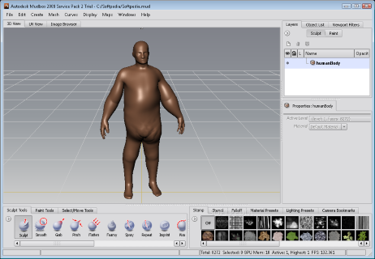
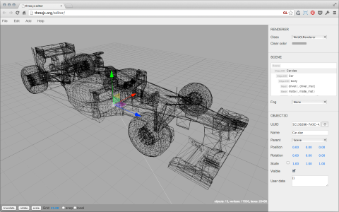
Motivations
Need for more profesional intensive applications (Music, Video, Programming, 3D editor, ...)
Autodesk 3d
WebGL Three.js Editor
Notes:
The big Change of App to user: Over the last two years a big change has been happening in the way applications are delivered to the end user.
Now all daily applications are moving to what is called "the cloud". Applications like
Cloud App: Mail (Gmail), office suites (Google Docs), Calendars, project managment.
But now a new breed is coming for more profesional intensive applications (Audio, Music, Video, Programming, 3D, ...).
(Mô hình chuyển từ máy tính để bàn sang trình duyệt trong tất cả các ứng dụng nhẹ hàng ngày), su chuyen doi cua Ung dung 3d Modelling Desktop => Browser

Slide 7
Industry Needs
The department was working on industry projects that required browser based 3D editors
2 years ago: Started developing a proof of concept 3D editor, meant to test the possibilities of the web for high-performance
Notes:
We have developed 3D desktop applications for the last 4 years for specific projects,
but 2 years ago we were approached by companies with specific needs, where they want to integrate 3D technologies in their existing pipelines,
which means they have to run anywhere and interact with other existing web technologies. So we started developing on the web.
------------------
过去四年:Phat trien ung dung 3D Native App trong 4 nam truoc
这两年来： 因为项目的需求, vi requirement cua project, muon 集成 3d technology vao 项目 hien co. => Phat trien ung dung 3d editor tren nen web (high performance)

Slide 8
What is an editor?
An environment where users can import resources, and arrange them to construct a semantic scene to share
In a 3D environment the resources are meshes, textures, materials, and other scene components (lights, cameras)
The result is an interactive 3D Scene available in any browser.
Notes:
At the beginning we werent sure if we could achieve a good quality product on the web, so we started developing our own editor with mild features (importing resources, moving them around, ...) but the developing cycles on the web are usually really fast thanks to the dynamism of Javascript, and the performance was much better than expected, so soon we had a full 3D web editor.
Gioi thieu khai niem Editor
Cong viec thiet ke ban dau chi don gian gom nhung feature don gian (import 资源, moving…model 3d).
Nhung trong qua trinh phat trien, 进度比较快, 发现出还有很多问题=》还可以添加一些高级功能.
能够将资源（3d model）导入并且编排为了构建一个语义场景（Semantic Scene）并分享
Va cuoi cung, ket qua la full 3d editor voi hign-performance da duoc thiet ke. Hoat dong tren hau het browser (any browser)

Slide 9

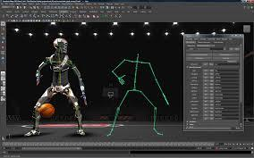
What's out there?
Realtime editors / Engines
Unity
Unreal Engine
Blender
Offline 3D Editors
Maya
3Ds Max
Cinema 4D
Notes:
This doesnt mean we think all software will be shifting to the web. Professional 3D authroing applications are still necessary due to the better performance and access to the hardware layer. But we find that there are some tools missing, and those could be developed on the web, for instance realtime editors where you can see the results of your actions instanly (instead of having to wait to an offline renderer).
研究背景

Slide 10
Web 3D Engines
Unity (now very common for cross platform 3D)
Flash 3D
Unreal Engine (WebGL version as of March 2013)
Three.JS (WebGL framework for js, run in browser)
Other WebGL Custom Engines...
VRML...
Notes:
There are some good tools for the web now, but most of them are just web-players, you export your data from a desktop applications and you can see the results on the web. They have an strong dependence on the desktop apps, and require more development complex pipelines.
Cac 3D Engine tren hau nhu duoc dung nhu Web-player(基于网页的3D player播放器）. Data duoc export tu Desktop App.
- Cac Engine nay có một sự phụ thuộc mạnh mẽ vào các ứng dụng máy tính để bàn（依赖于本地3d建模的应用）,
- và yêu cầu phát triển đường ống phức tạp hơn. （需要开发更复杂的管线）

Slide 11
Challenges of Web-based 3d integration
Efficient local/remote management of large volume assets and data
Scene setup and editing using such assets
Correct export of render settings to ensure the scene can be viewed correctly in different environments.
Notes:
Problem:
1） 当前的3d web 应用因为基于网页端，所以无法完全利用到硬件的资源， 就像(本地应用)一样执行.
2）这样问题更加严重如果缺少了一个管线（pipeline）和工具为了创建，编辑和 输出 3D场景到网页上显示。
==》3d集成在web里面还存在一些挑战性问题（）:
有效的管理 本地/远程 大量数据和资源
Thiết lập cảnh và chỉnh sửa bằng cách sử dụng tài sản đó
chính xác xuất khẩu các thiết lập render để đảm bảo cảnh có thể được xem một cách chính xác trong các môi trường khác nhau.

Slide 12
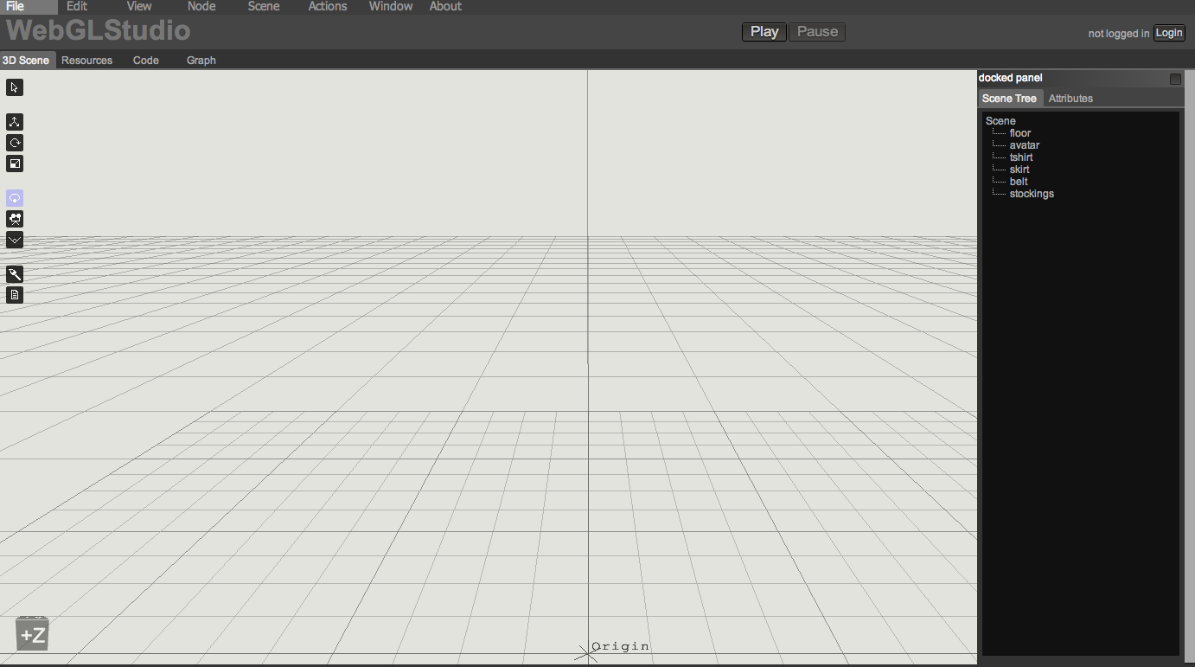
WebGLStudio overview
Core Engine
Render Pipeline
Editor
Resources Manager
Post-processing effects
Particle Engine
Realtime mesh painting
Scene saving / export
Notes:
So we present our own tool, which features some advanced options as a proof of concept that complete 3D suites can be build on the web. Our engine features a high quality rendering pipeline, resources management and some other cool features we will see now.
Gioi thieu bo cong cu Web 3d Editor voi nhung tuy chon cao cap (高级选项）
Chung minh rang 1 complete 3d editor hoan chinh co the duoc xay dung tren nen Web.
本论文将介绍一个Web 3d Editor
系统里面的引擎采用了高质量的3D渲染管线（管道）（Pipeline).

Slide 13
Core Engine
Lightweight low level library to wrap most of WebGL functionality, called LiteGL
Classes for basic components in 3D: Mesh, Texture, Buffer, Shader
Mathematics: uses glMatrix, adds other classes like Octree, RayTesting, AABB, ...
LiteScene library to handle the Scene Graph
Classes: Scene, SceneNode, Component.
Camera, Light, ...
Resources Manager
Notes:
The Core Engine（内核引擎） of the application is divided in two layers:
a low level layer wrapping WebGL to make it easy to use and abstract the programmer from the ugly API calls.
a Scene Graph library with a rendering pipeline.
This two layers can be used separately without the need of all the complexity of our editor, this way we can include the results of our editor in any webapp with ease.
He thong duoc chia lam 2 layer-两层
第一层: 将WebGL function封装起来，将一些丑陋的API也抽象化。 为了方便使用,
=》 基本3D组成类（3D Component） : Mesh(网孔）, Texture（质地）, Buffer（缓冲）, Shader （着色器）
第二层：LiteScene库为了控制，操作场景图。

Slide 14
Core Engine main features
Scene Graph
Component based
Resource Management
Binary formats for fast loading
Meant to high quality rendering
Works in Firefox and Chrome (not tested fully on Safari)
Notes:
核心引擎的主要特点
-----------------
From the features perspective, our Core Engine has a Scene Graph where every node on the Scene contains components that expand its functionalities,
从功能的角度来看，我们的核心引擎有一个场景图，
其中的场景的每个节点包含扩展其功能组件，
This makes it really easy to add new features to the scene, for rendering but also for interaction.
Add feature： 通过这个方法，给场景添加新功能变得非常简单，
------------------------
资源管理 (Resource Manager): It has a resource management where files can be easily stored and organized on the server.
自定义数据格式(Binary format)：We have our own binary format to store any kind of data, improving the parsing （解析）stages during loads. (加载3D场景的时候，提高解析效率）
高质量的渲染器 We achieve（实现) a high quality rendering thanks to a complete shader solution. And it has been tested in several computer with different specs without problems.
Nho vao he thong do mau
系统有着色器的解决方案（render solution) =》能够提供高质量的渲染器 , he thong da co mot high-quality of rendering(渲染器).
Rendering nay da duoc test tren nhieu may tinh khac nhau (voi cac 参数 khac nhau) va deu ko xuat hien bug

Slide 15
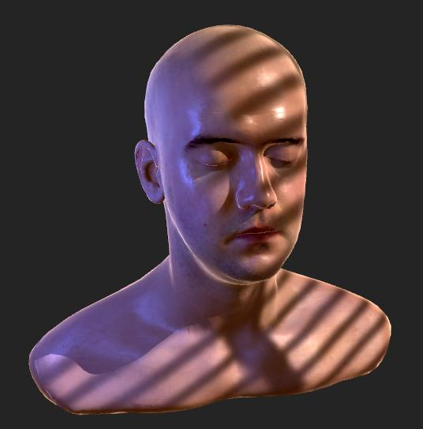
Core Engine
Notes:
实现High-quality of rendering with 完整的着色解决方案 (complete shader solution)

Slide 16
Render Pipeline
Generates the shader according to the material properties (ubershader)
Supports multiple lights (omni, spot and direct) with projective texture, realtime reflections, shadows with shadowmaps, postprocessing FX, multiple textures per material.
Events system to hook to any rendering stage
Notes:
Render Pipeline （渲染器管线）
Our system provides a complex material class that can generate the appropiate shader instantly, this way the user doesnt need to know about different shaders, just playing around with the material properties he can see the results at the very moment.
Because we know the platform has to be easy to extend, we have an events system where any module can hooks its own actions allowing to extend or replace the existing functionalities without problem. Thanks to the power of javascript paradigms.
Some of the rendering features are realtime reflections...
（系统提供一个复杂的材料类）=》 系统会自动根据3d Model的材料来产生相应的着色。用户只需要调节3d模型材料的属性就立刻能看到结果。不需要关心到有不同的着色器。
WebGL Studio系统也支持多种光线（omni（泛光灯），spot聚光灯 或 direct直射光）。 材料的多纹理。
应用里面也设计了一个事件的子系统，（Events System），为了挂钩到每个渲染3d的阶段。
解释： 任意一个模块都可以挂钩自己的action在上面，为了方便扩展或者代替功能（function）？？

Slide 17
Editor
Allows to construct scenes from a set of meshes and textures
Pixel-perfect picking for selection
Familiar 'desktop app' interface (Menus, Tools, Gizmos, Attributes editor, keyboard shortcuts ...)
Easy to add new assets from the hard drive (drag and drop to upload to server)
Easy to extend (modular architecture)
Notes:
编辑器的介绍
So how does our editor work.
从一组网格和纹理，用户可以构造一个场景
1）操作界面像本地 3D Modelling应用 （包含菜单，对话框，节点和属性。。等等。）： Most of the UI is familiar with most of 3D existing editors, it has picking, menus, dialogs, every node has a set of attributes, etc.
2) 非常方便 导入材料和数据The user starts a project importing several assets (from the Hard drive or the remote repository).
He can arrange them, tune the material properties, and add some basic behaviours, and finaly save it to share it.
3）模块化的设计结构 (方便的编写和添加插件plugins）： And it allows to code plugins very easily, just by including an extra javascript file, without the need to change more lines of code.

Slide 18
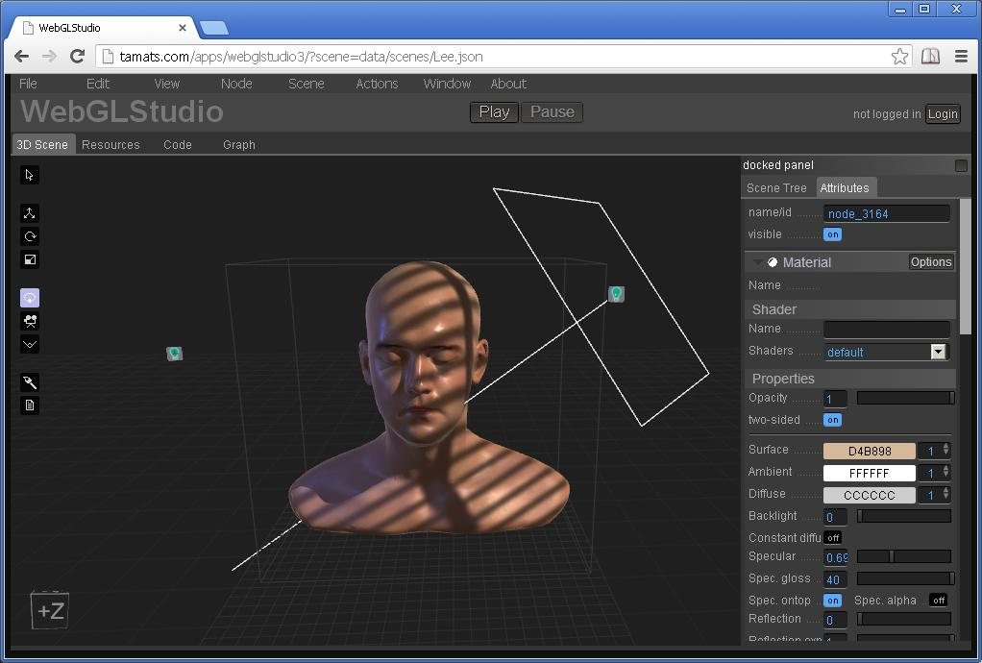
Notes:
Here you can see the interface, in the left side we have the tools and in the right side all the properties of the selected node of the scene.

Slide 19
Resources Manager
Sync'd with the server
Allow to easily upload any kind of asset
Textures
Meshes
Materials
Scenes
Prefabs
Generates a preview image to easy browsing
Allows to add comments or other info
Notes:
资源管理
由于有安全
资源可以与服务器同步
--------------
One of the main issues when working with 3D on the web is that assets cannot be stored on the user computer due to security reasons, so all the resources have to be on the server. This is achieved with a server layer that handles the storage and adds some useful actions like version control, comments, metadata, etc. The server doesnt need to know the type of file so we can store any kind of assets, even scripts.
Every assets have some useful metadata (author, time of creation, etc) plus a preview image to help during browsing.

Slide 20
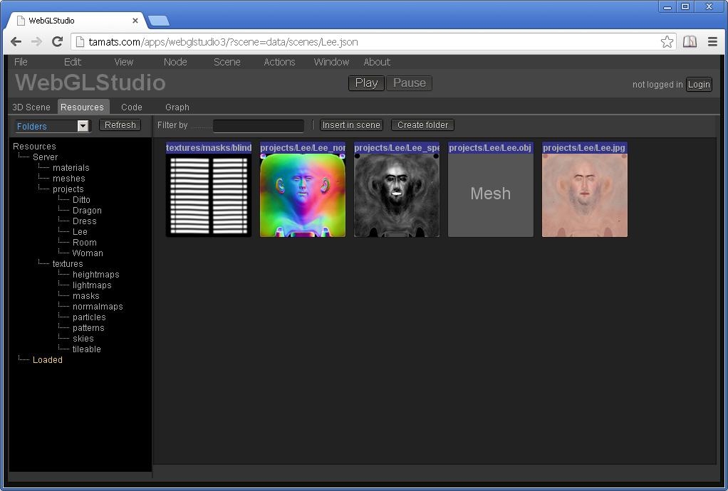
Resources Manager
Notes:
The folder structure on the left represents the folders on the server. And just by draging the files you can store them or move them from one folder to another.
服务器的目录结构。

Slide 21
Post-processing FX
Some basic post-processing effects using Color and Depth information
Color curves
Depth of Field
Edges
Lens distortion
Notes:
Other interesting features we have been testing are how some common high-quality rendering technics could be included in our web editor. For instance Postprocessing effects, even the ones using scene information, like the depth.

Slide 22
Particle Engine
Particle emisor with several configurable settings:
Alpha and size curves to control over time
Animated textures
Plane, Sphere and Mesh emisors
Notes:
Also we wanted to explore more CPU intensive areas of the rendering, like particle engines, where the work is split between the CPU and the GPU.
We wanted to have a complex particle system, that allows to create interesting scenarios, and for that you need to support animated textures, curves for properties over time, basic phisics, etc.

Slide 23
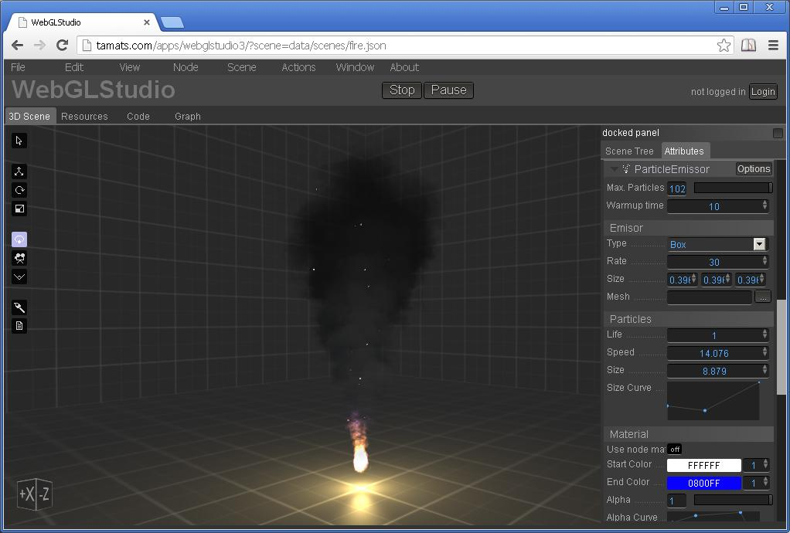
Particles
Notes:
This is an advanced scenary that we thought wouldnt perform adequately on the brower, due to the CPU intensive nature of the app, however the performance is very good thanks to the power of latest Javascript engines. The mesh have to be updated every frame and despite of that, the framerate is very good.

Slide 24
Realtime mesh painting
Allows to paint any channel of a material directly on the browser
Octree to test collision
Paints pixel around the area of collision using an unwrap of the mesh.
Notes:
We also wanted to test if it would be possible to edit the assets somehow, so our first idea was to create a 3D painting tool. Our algorithm uses an Octree to compute the cursor collision with the mesh, and using the UVs as vertex positions computes the distance of every texel of the texture with the point of collision, allowing to do very precisse strokes over the mesh.

Slide 25
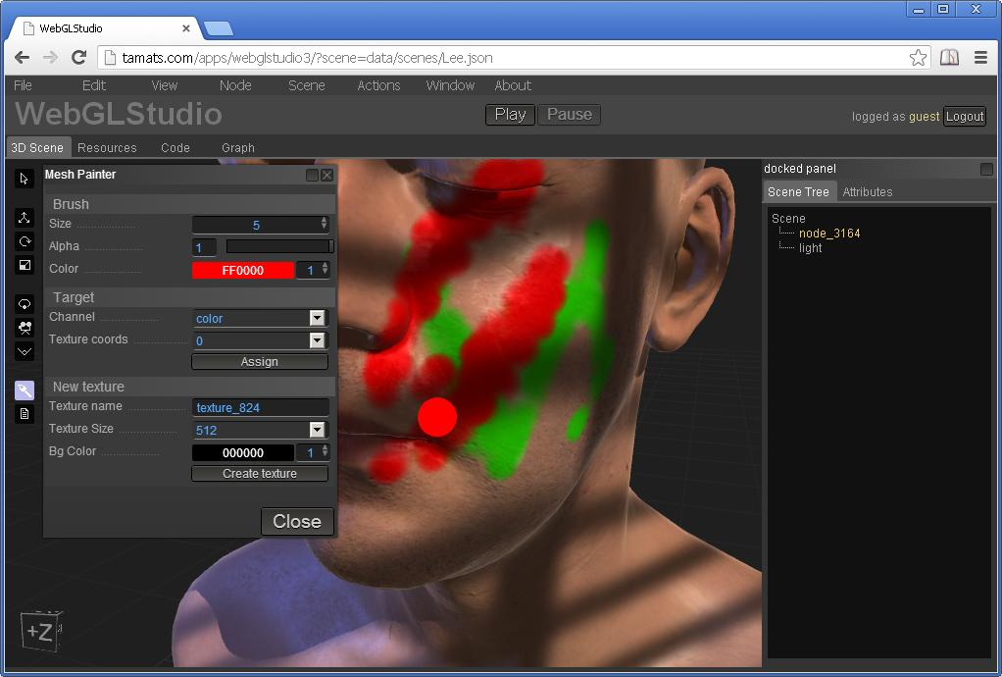
Mesh Painter
Notes:
And you are not limited to paint on the color channel, you can also paint on any other layer (opacity, specular, reflectivity, ...)

Slide 26
Performance
WebGL Studio is achieved 60fps in scenes with several lights and meshes using mid-specs computers.
The performance drops when having tens of meshes if the shader is too complex

Slide 27
Conclusions
WebGL + aspects of Javascripts = very suitable match for creating a 3D Editor
"Democratization" of 3D technology - give 'non-technical' users the ability to create interactive 3D scenes that can be distributed for the web

Slide 28
Thanks!
Q&A

